Slide 1

AI-Powered Fixed Deposit (FD) Rate Comparison Agent
Navigating the world of fixed deposits can be challenging, especially for senior citizens. Manually comparing FD rates across multiple banks is time-consuming and inefficient. Our AI-Powered FD Rate Comparison Agent offers a seamless solution, fetching the latest rates from top banks like ICICI, HDFC, and Kotak Mahindra, and presenting them in an easy-to-understand format. This innovative platform is designed to simplify financial decisions, ensuring you get the best returns with minimal effort.

Slide 2
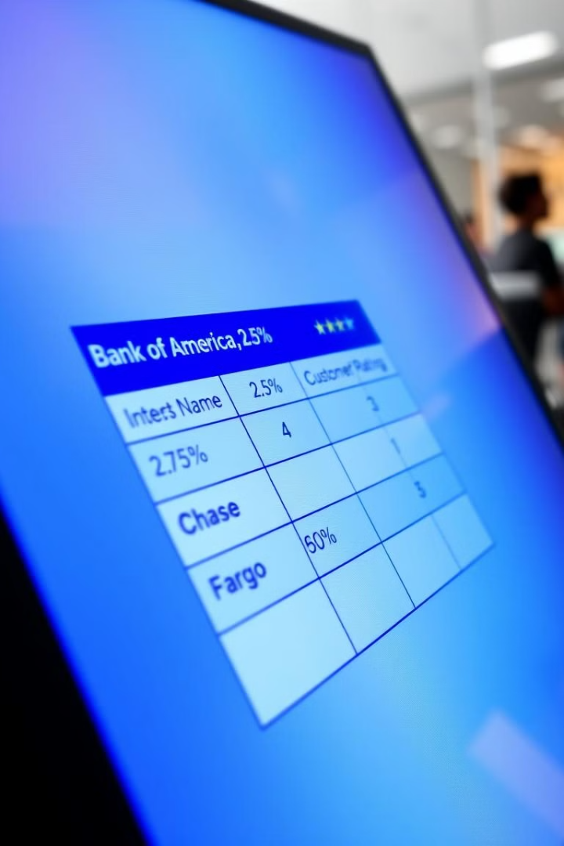



Core Features: Simplifying Financial Decisions
AI Web Crawling
Automated Data Parsing
Automatically extracts FD rates, tenures, and terms from various banking websites, ensuring you have the latest information.
Processes and structures extracted data into a user-friendly comparison table, making it easy to review and understand.
Dynamic Updates
Ensures real-time data retrieval or scheduled periodic updates, so you're always viewing current rates.

Slide 3




Personalized Recommendations: AI Tailored to Your Needs
Intelligent Recommendations
Based on your preferences (tenure, investment amount), the AI suggests the best FD options for your specific needs.
Graphical Visualization
Interest rate trends are displayed graphically, making it easier to spot patterns and make informed decisions.
Voice-Based Queries
Senior-friendly accessibility allows you to ask questions and receive answers via voice commands.

Slide 4
Tech Stack: Combining Power and Simplicity
Backend (Python)
Frontend (JavaScript)
AI Engine (Google Gemini)
FastAPI: For building the API.
Interactive web page for user-friendly access.
Generates personalized recommendations and trend analysis.
Pandas & NumPy: For data manipulation and analysis.
Matplotlib: For generating graphical representations.

Slide 5

AI-Generated Personalized Recommendations
User-Centric
Human-Friendly
AI learns from user inputs (tenure, budget, situation) to suggest the most suitable FD.
Gemini AI generates clear and simple recommendations, avoiding financial jargon.
Real-time Analysis
Analyzes data to provide the best option.

Slide 6




Trend Analysis: Visualize Your Investment Journey
Historical Data
Plots historical FD rate trends using Matplotlib for visual analysis.
Trend Identification
Helps identify patterns and potential opportunities.
Base64 Encoding
Graphical representations are returned as Base64-encoded images for easy integration.

Slide 7



FD Calculator: Estimate Your Maturity Amount
Principal
1
Investment amount
Rate
2
Interest rate
Tenure
3
Investment duration
Easily compute your maturity amount based on investment amount, interest rate, and tenure. This feature allows you to forecast potential earnings and plan your financial future with confidence. The FD Calculator API provides instant results, making financial planning straightforward and efficient.

Slide 8






Senior Citizen-Friendly Chatbot: Your Personal Assistant
Simple Language
Provides easy-to-understand responses, avoiding financial jargon.
Conversational Interface
Tailored for senior citizens to assist with FD-related queries.
Voice Output
Future scope includes voice output for enhanced accessibility.

Slide 9




Future Expansion: Enhanced Accessibility and Functionality
Multilingual Support
Ensures accessibility for non-English speakers.
Database Migration
Plans to migrate from CSV-based data to a robust database (e.g., PostgreSQL).
Cloud Deployment
Can be hosted on cloud platforms like AWS, GCP, or Heroku.

Slide 10

Key Takeaways: Empowering Your Financial Future
Our AI-Powered FD Rate Comparison Agent is designed to empower you with accurate, real-time financial insights. By automating the comparison process, providing personalized recommendations, and offering a user-friendly chatbot, we aim to simplify your financial decisions. Whether you're a senior citizen or any investor, our platform ensures you get the best returns with minimal effort. Embrace the future of financial planning with our innovative solution.

Slide 11
USER INTERFACES
01

Slide 12
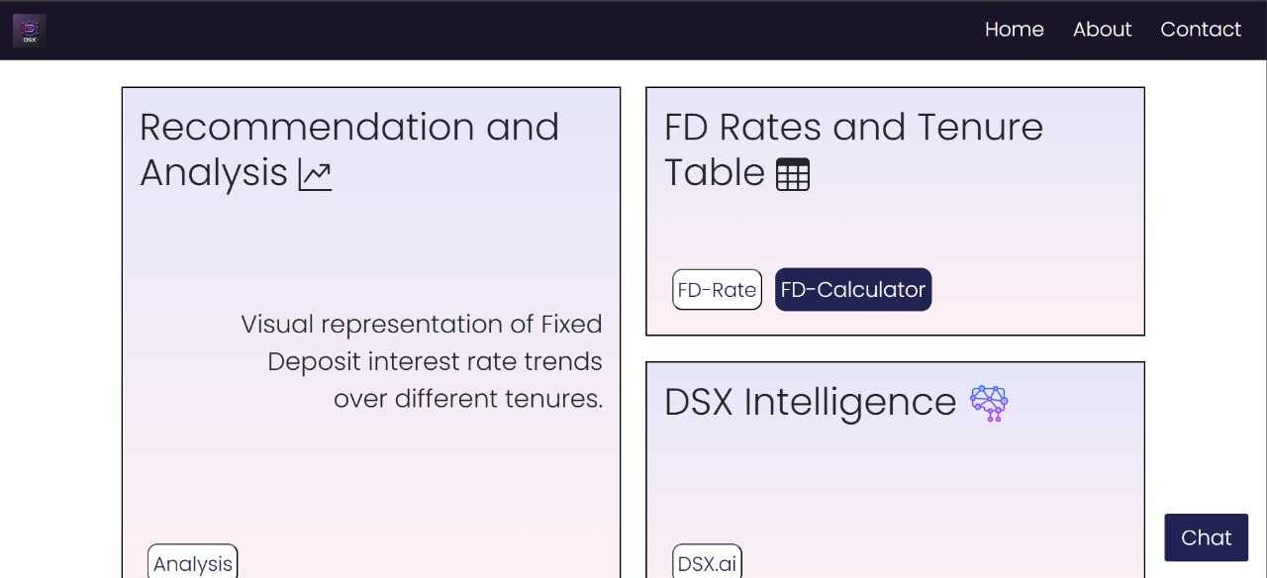

Slide 13
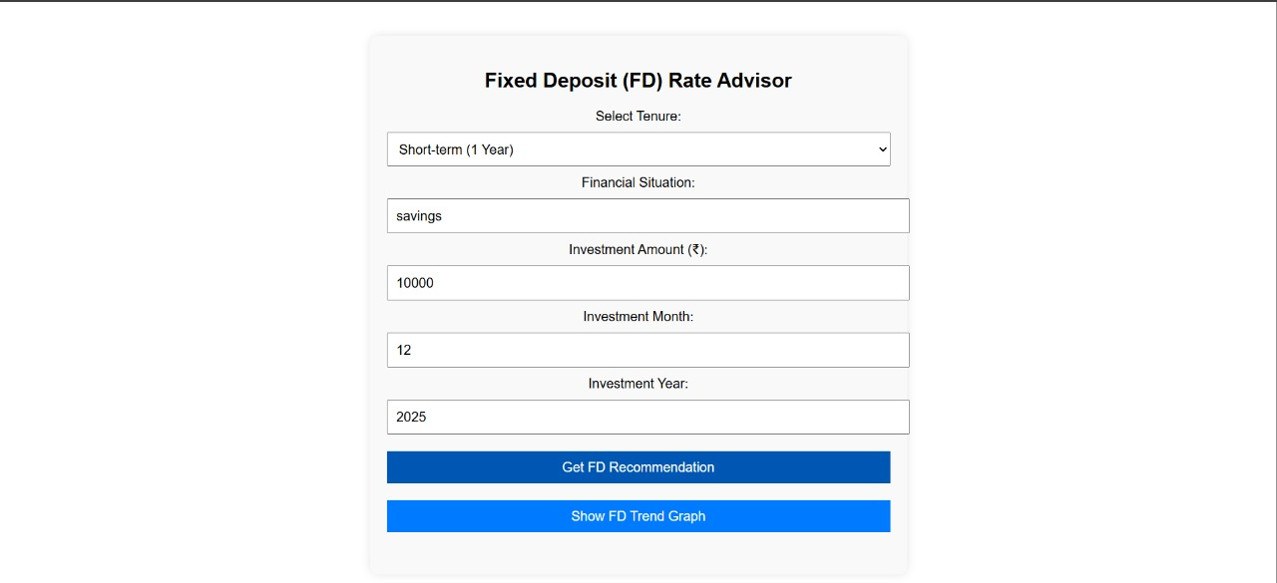
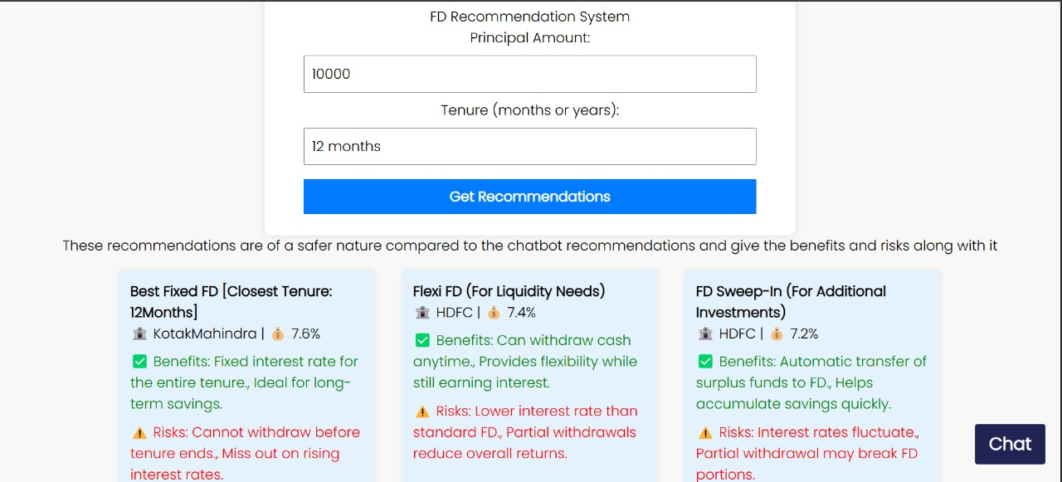
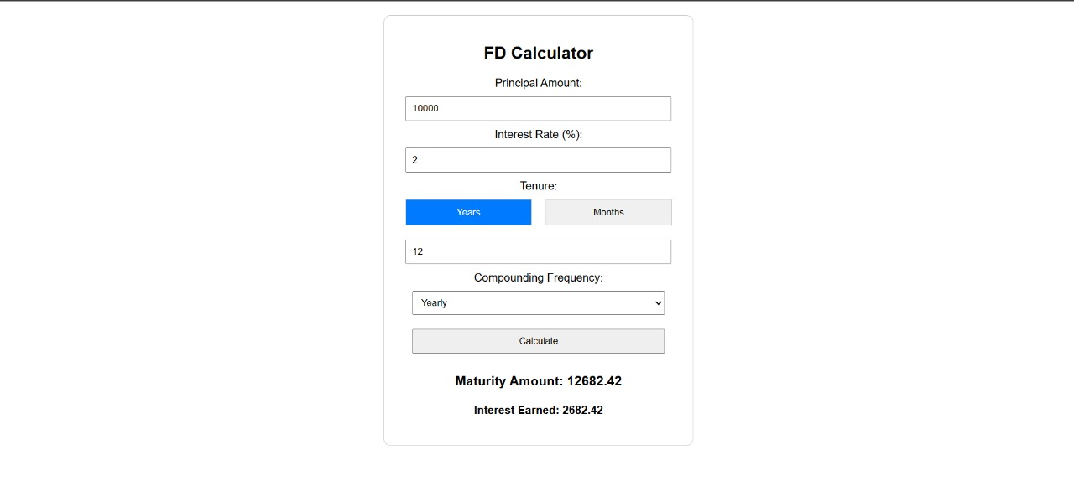
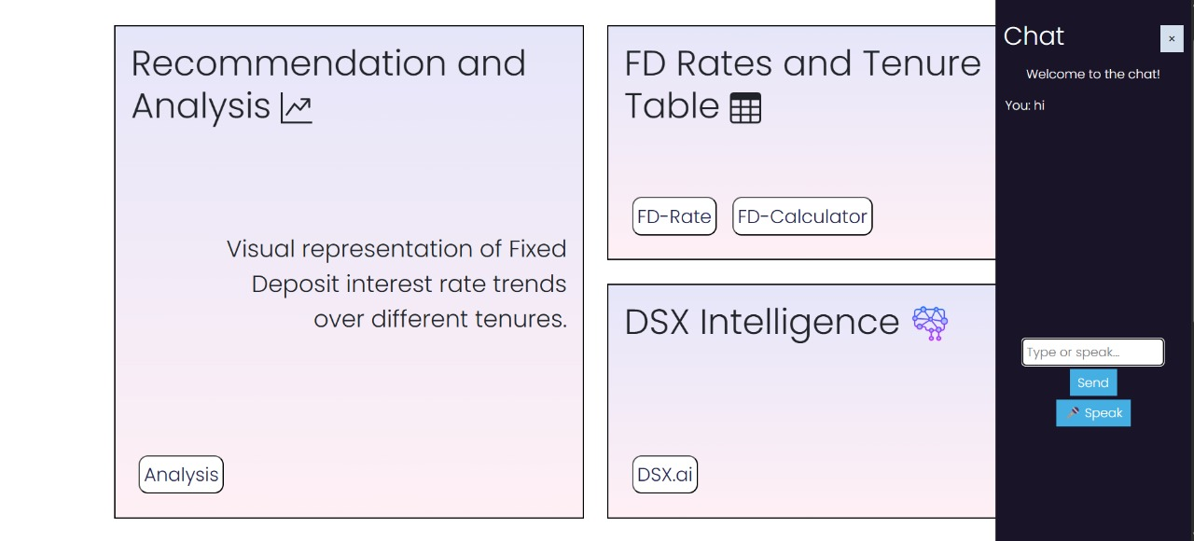
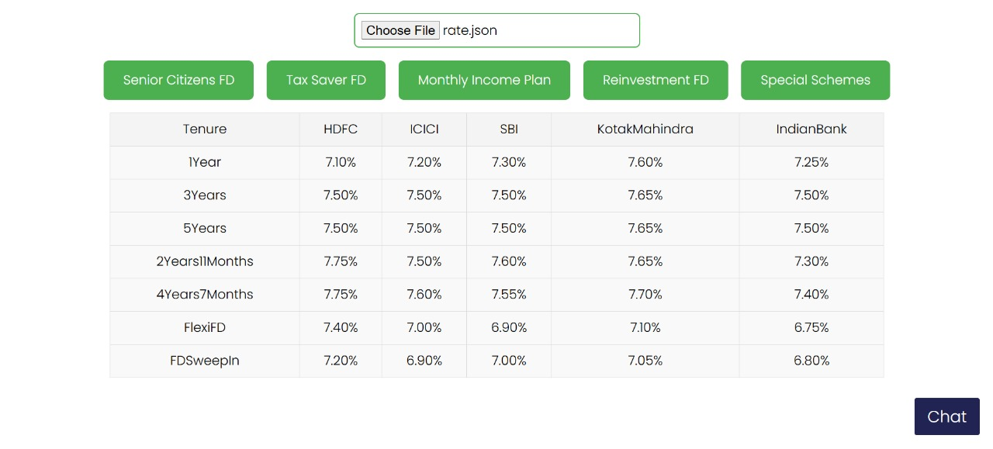
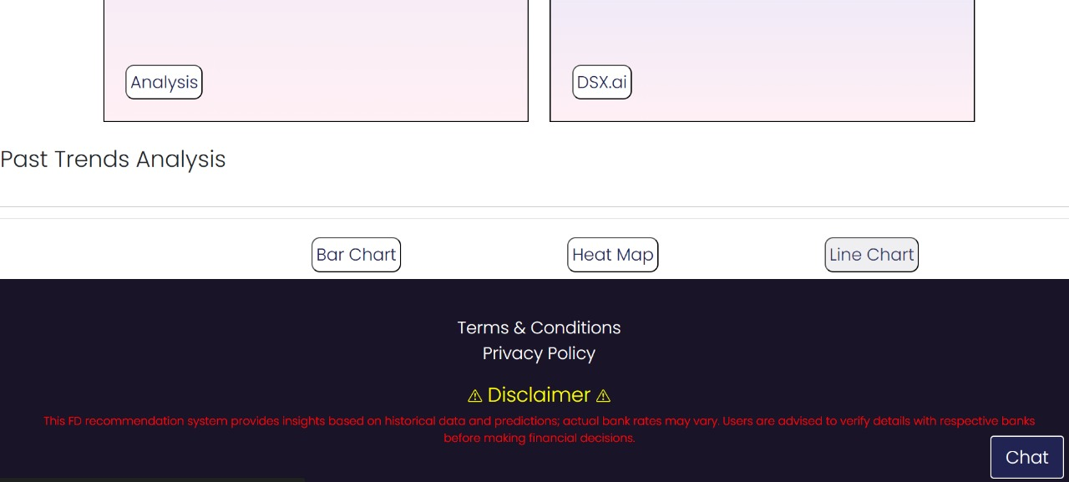
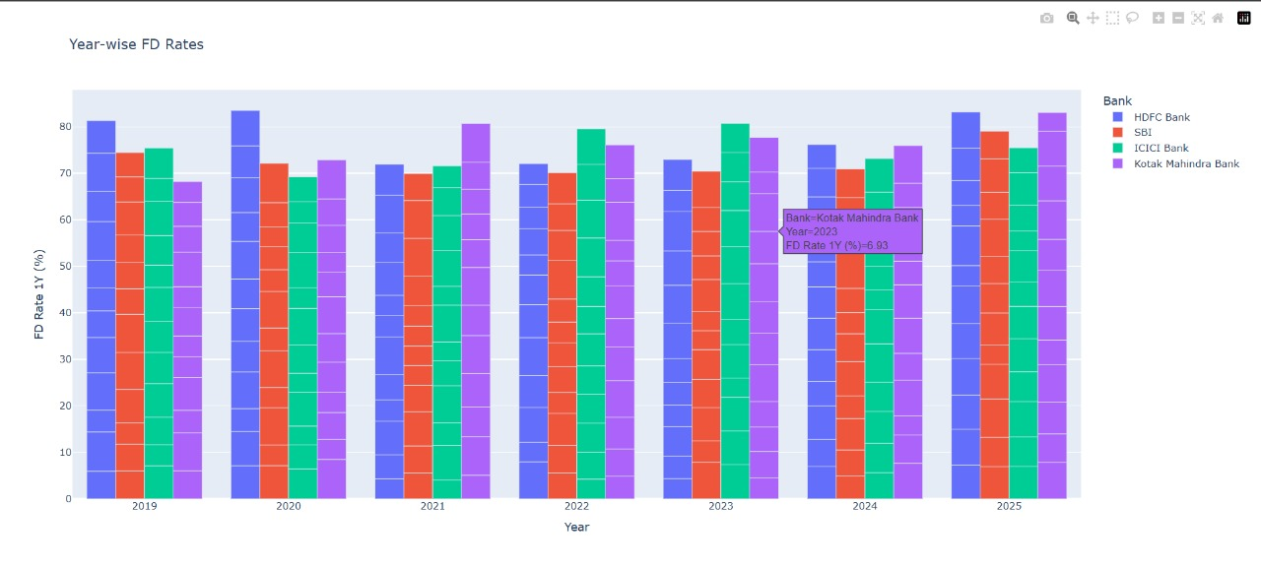
blob:https://web.whatsapp.com/8a590122-b612-42b0-9518-779897df0c1e

